Slide 1
State of Land in the Mekong Region
© Justin Mott

Slide 2
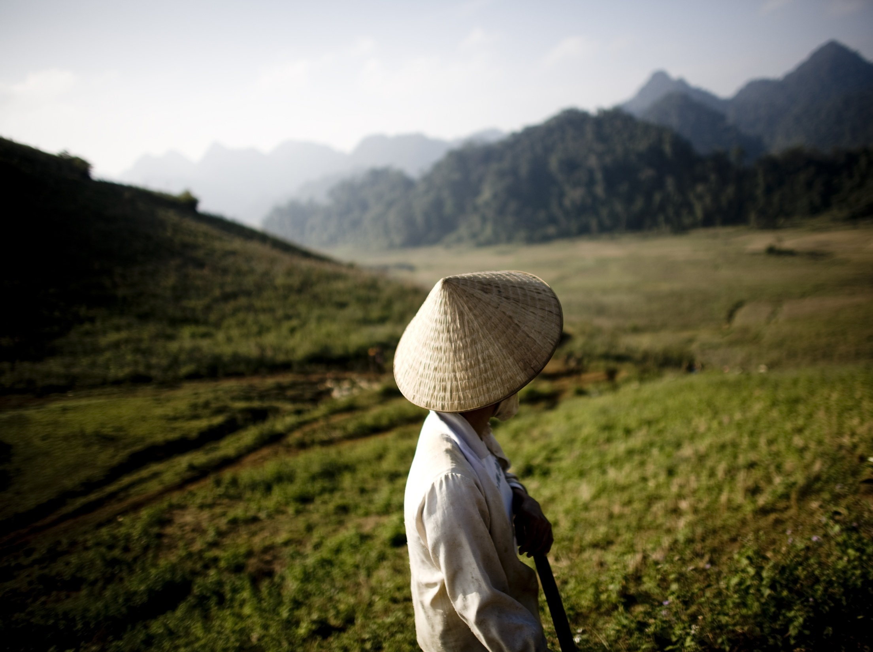
Objectives
Collate updated data and information to identify and describe key issues and processes revolving around land in the Mekong region
Provide a basis for constructive dialogue and collaborative decision-making with different actors to address these issues
© Justin Mott

Slide 3
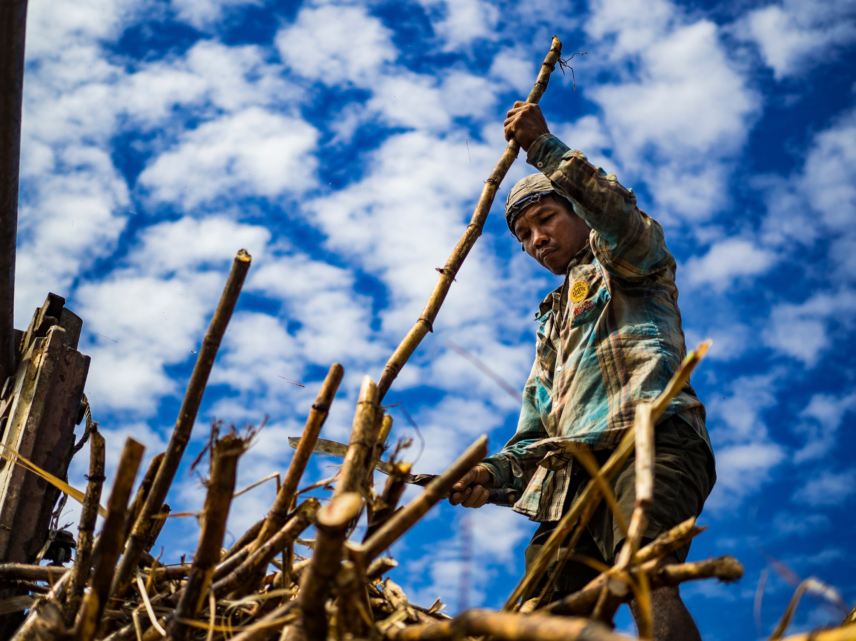
A truncated agrarian transition: smallholder farmers will need land !
The share of agriculture in GDP has decreased in each country but the agricultural population has decreased less rapidly. Migrations to rural areas are greater than rural-urban migrations, and are driven primarily by the search for agricultural land
© Jack Kurtz

Slide 4
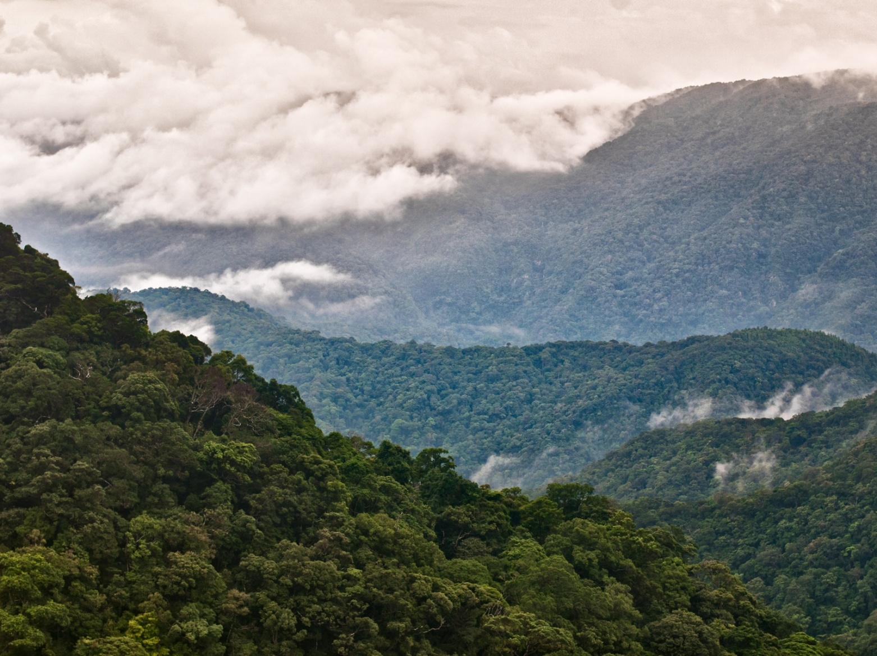
Unprecedented land use changes
The key trend is the conversion of forest into agricultural land. Agricultural land area grew by 9 million between 1996 and 2015 (a 20% increase), primarily at the expense of forests. The main contributing factors have been the growth of global trade in agricultural commodities and the related rise of agricultural investments.
© Thomas Calame

Slide 5
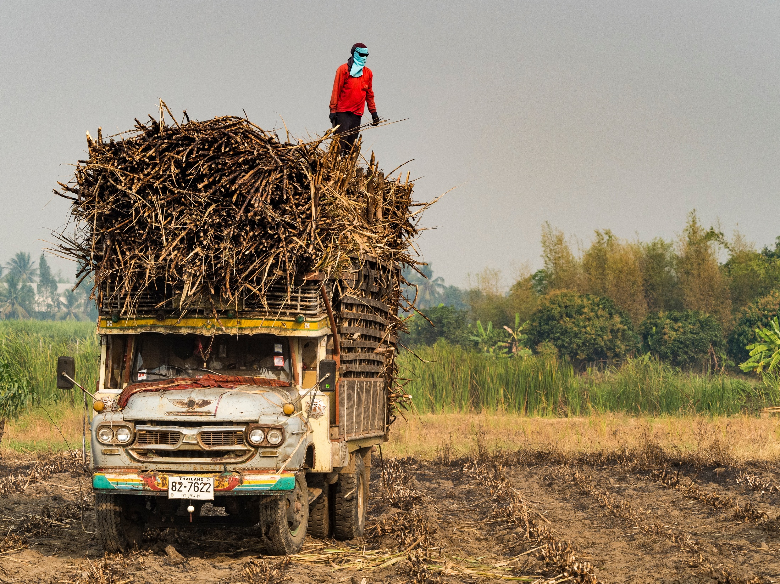
Simplification of agricultural landscapes
Global trade of agricultural commodities is particularly important for the so-called boom crops. Together with rice, rubber, cassava, corn, sugar cane and oil palm cover more than 80 percent of total land cultivated in the Mekong region
© John Kurtz

Slide 6
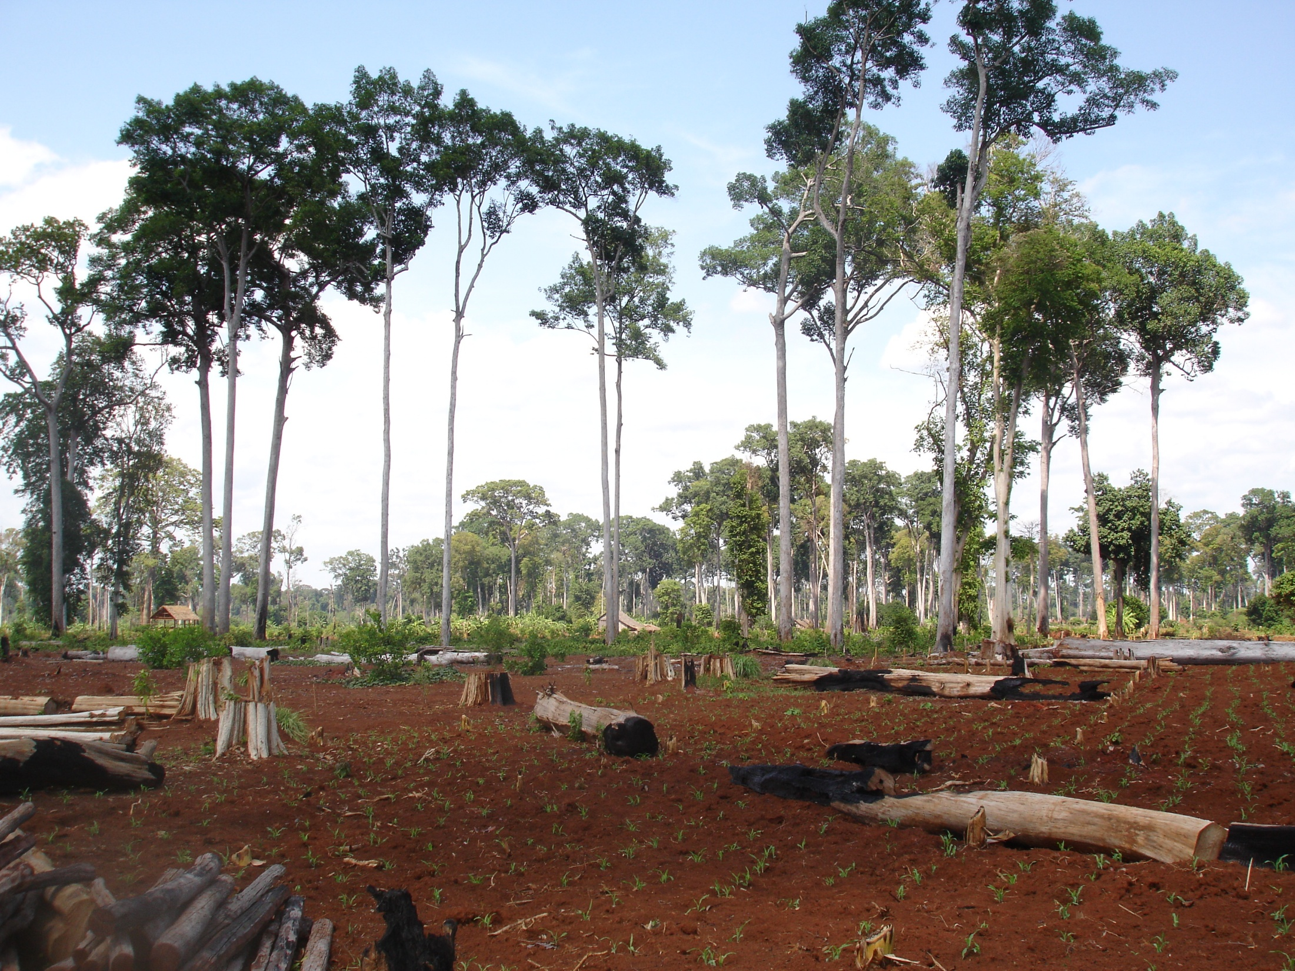
Degradation of the land resource base
82 percent of all land in the Mekong region has undergone medium to strong degradation. 30 percent of these areas are considered to have high ecosystem service values.
© J.-C. Diepart

Slide 7
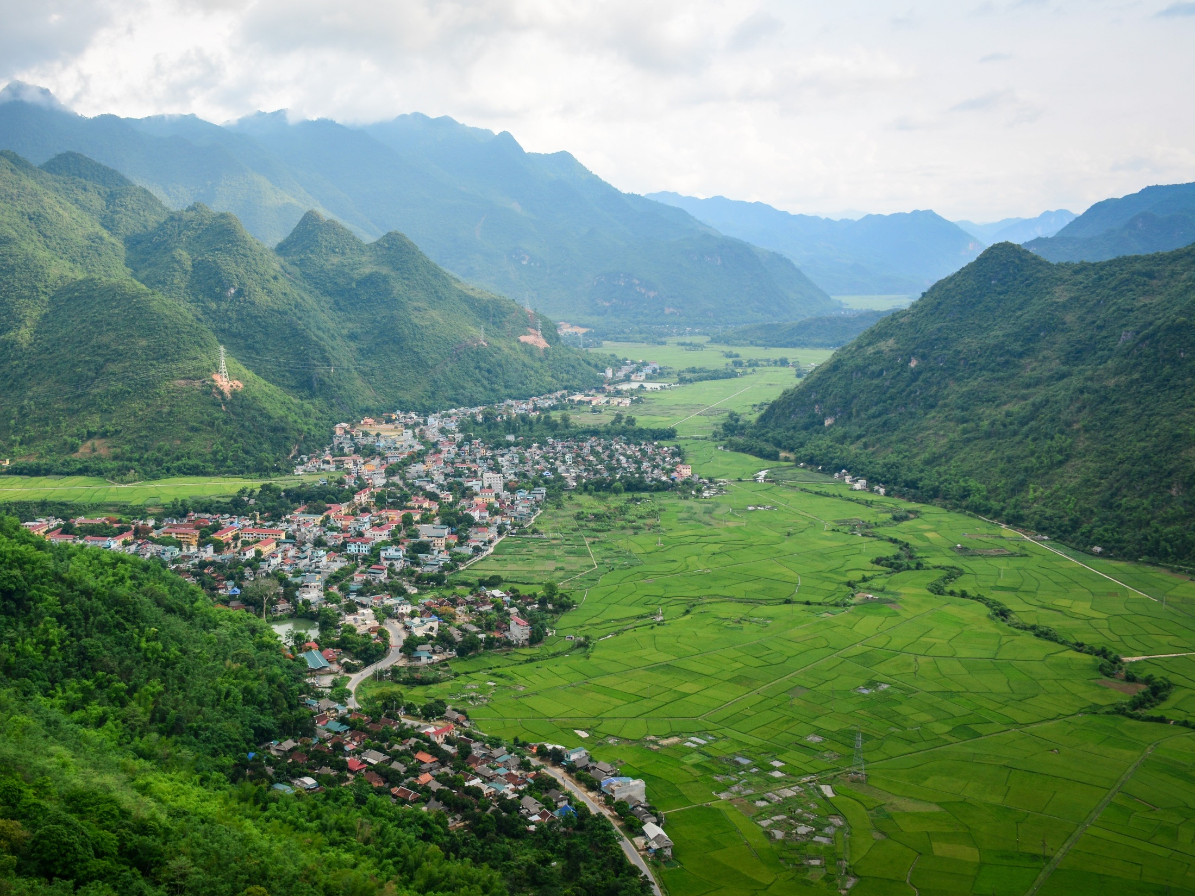
Persistence of smallholders amid growing inequality
The majority of agricultural land in the Mekong is cultivated by smallholders. Average agricultural land holdings vary by country, from a low 0.7 ha per household in Vietnam to a high of 3.1 ha in Thailand. A critical characteristic is the inequality of land ownership: Gini indexes on agricultural land distribution are high and on the rise in each country. Land markets and high incidence of indebtedness are key explanatory factors
© Lang Du

Slide 8
The rise and fall of land concessions for agriculture?
Except in Thailand, a concession model has been adopted to promote large-scale agricultural production, mainly in peripheral uplands. Large areas of land allocated to companies have resulted in a dramatic transformation of the agrarian structure. But concessions have not kept their promises. Governments have cancelled many concessions and are considering new forms of investments that are potentially more cognizant of smallholder farmers’ land rights
© John Kurtz

Slide 9
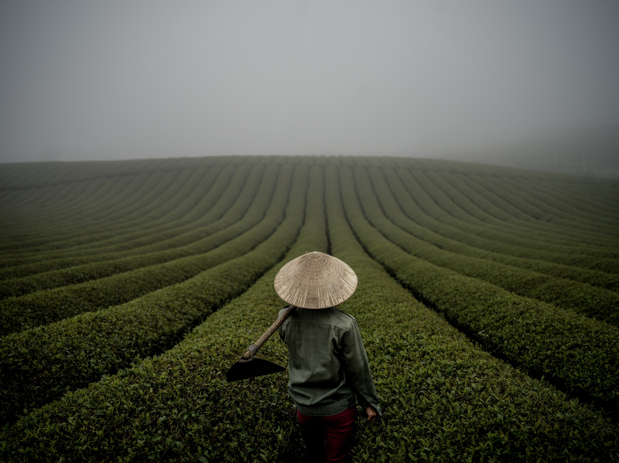
Formalization and recognition of land rights: unfinished reforms
The main approach to secure land rights for smallholders has been through individual titles or land use certificates. While this varies by country, a common feature across the region is the systematic exclusion of certain types of land eligible for titling, particularly within state forests and high-value areas. At the same time, the recognition of customary land tenure – particularly through collective arrangements – has been a very limited and State-controlled process.
© Justin Mott

Slide 10
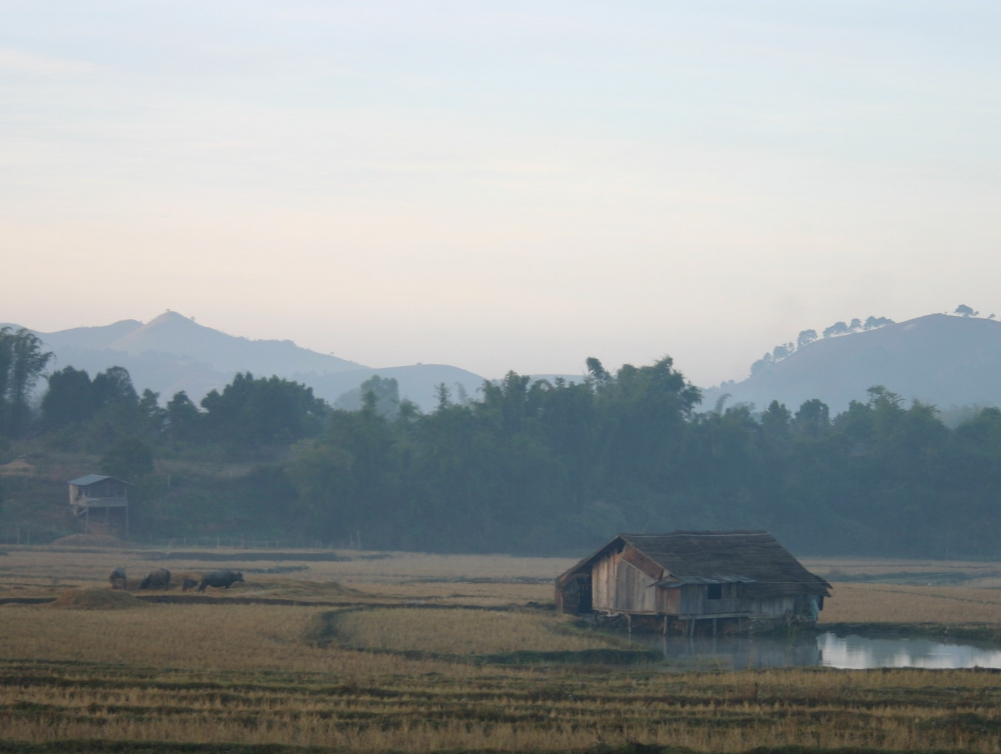
Gap between policy and practice
Despite a wide diversity in legal frameworks guiding the administration of land in the Mekong region, a key characteristic of land governance is the large gap between policy and practice. Land conflicts are rife across the region and smallholder famers have limited access to transparent, adequate and affordable resolution mechanisms. The protection of land rights of ethnic minority groups is a key concern in the governance of land resources.
© Micah Ingalls

Slide 11
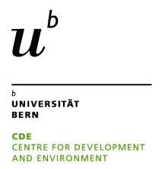
Produced by:
With funding from:
Ingalls, M.L., Diepart, J.-C., Truong, N., Hayward, D., Neil, T., Phomphakdy, C., Bernhard, R., Fogarizzu, S., Epprecht, M., Nanhthavong, V., Vo, D.H., Nguyen, D., Nguyen, P.A., Saphangthong, T., Inthavong, C., Hett, C. and Tagliarino, N. 2018. State of Land in the Mekong Region. Centre for Development and Environment, University of Bern and Mekong Region Land Governance. Bern, Switzerland and Vientiane, Lao PDR, with Bern Open Publishing.

